Slide 1
Develop a system to store, analyze, and visualize Twitter’s tweets
Phase – 1 : Collect Tweets using Twitter’s Streaming APIs
Run the WordCount example in Apache Spark on the collected tweets
and
collect the output and log files
TEAM:
SHUCHITA KHANDELWAL
ANUJA SAWANT
TARUN CHANDRASHEKAR
SHUBHABRATA MUKHERJEE

Slide 2
Tools & APPLICATIONS used
1.Python
2. Twitter API tokens
3. Tweepy
4. JVM
JSON
SPARK
SCALA

Slide 3
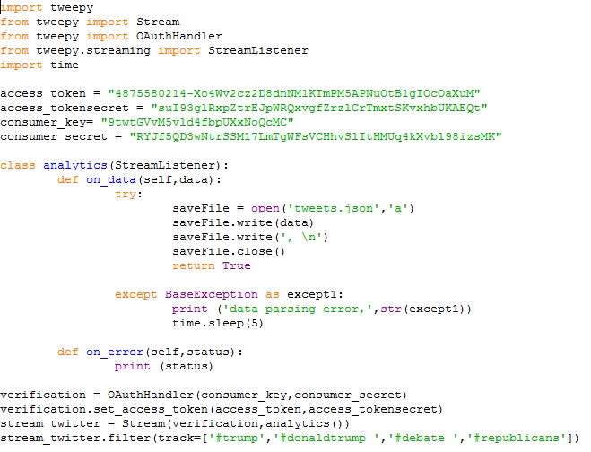
COLLECTING RAW TWEET DATA

Slide 4
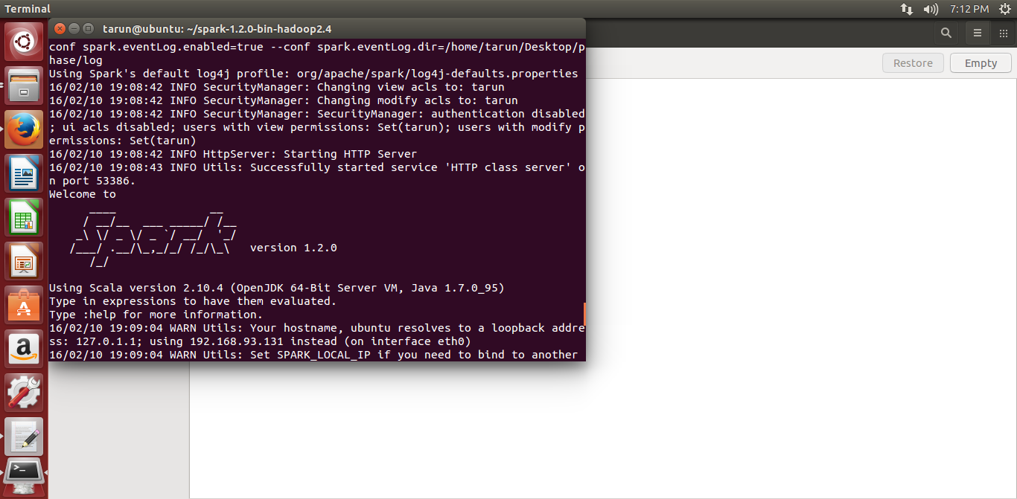
RUNNING SPARK

Slide 5
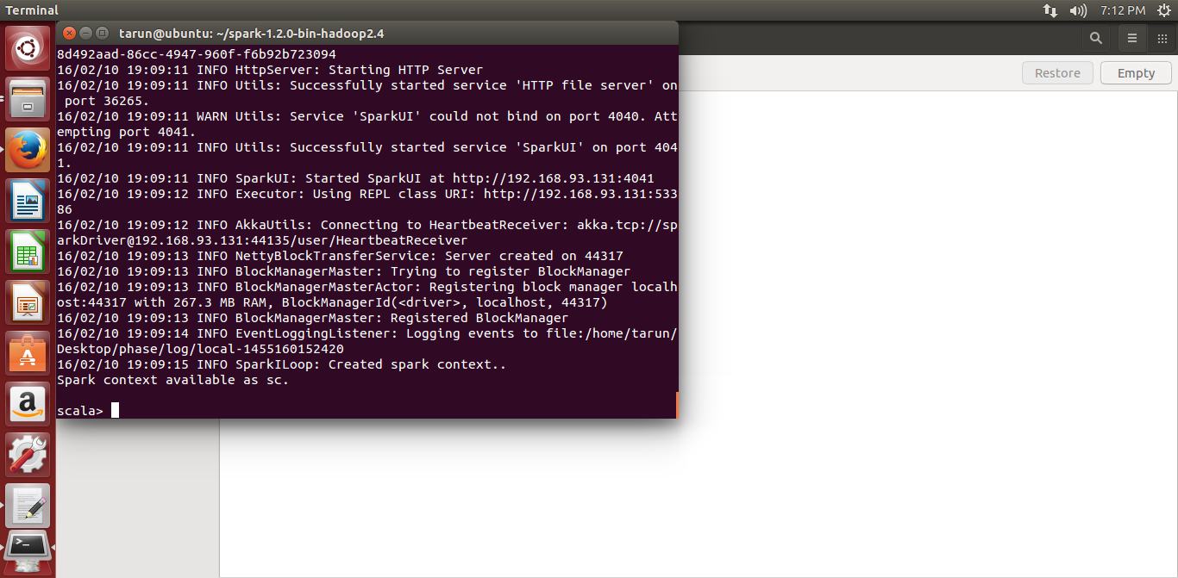
RUNNING SPARK CONTD.

Slide 6
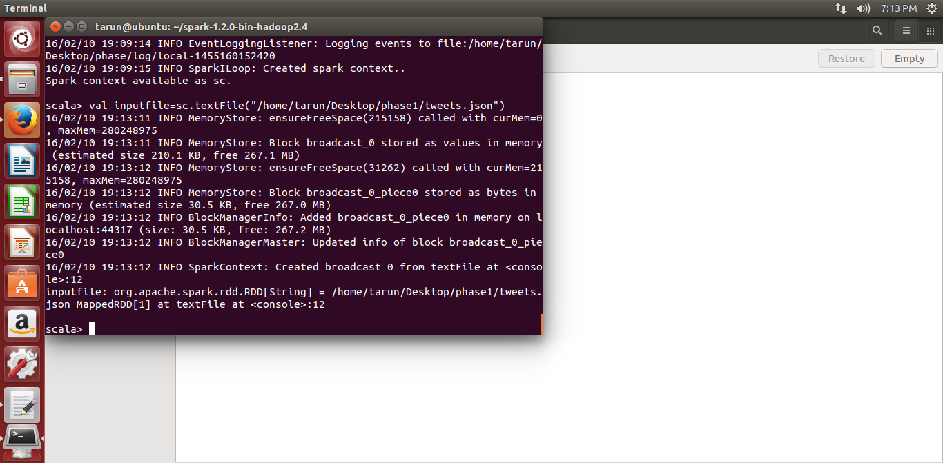
RUNNING WORDCOUNT PROGRAM

Slide 7
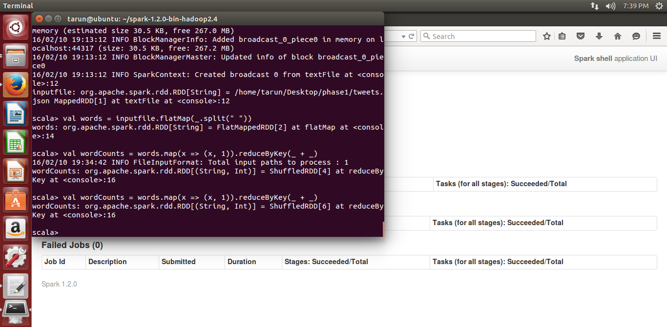
WORDCOUNT PROGRAM CONTD

Slide 8
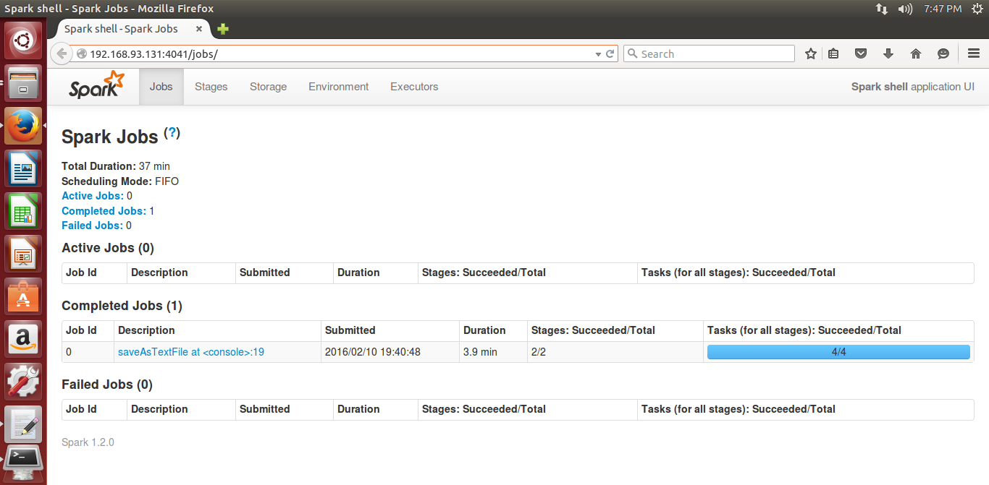
WORDCOUNT PROGRAM CONTD

Slide 9
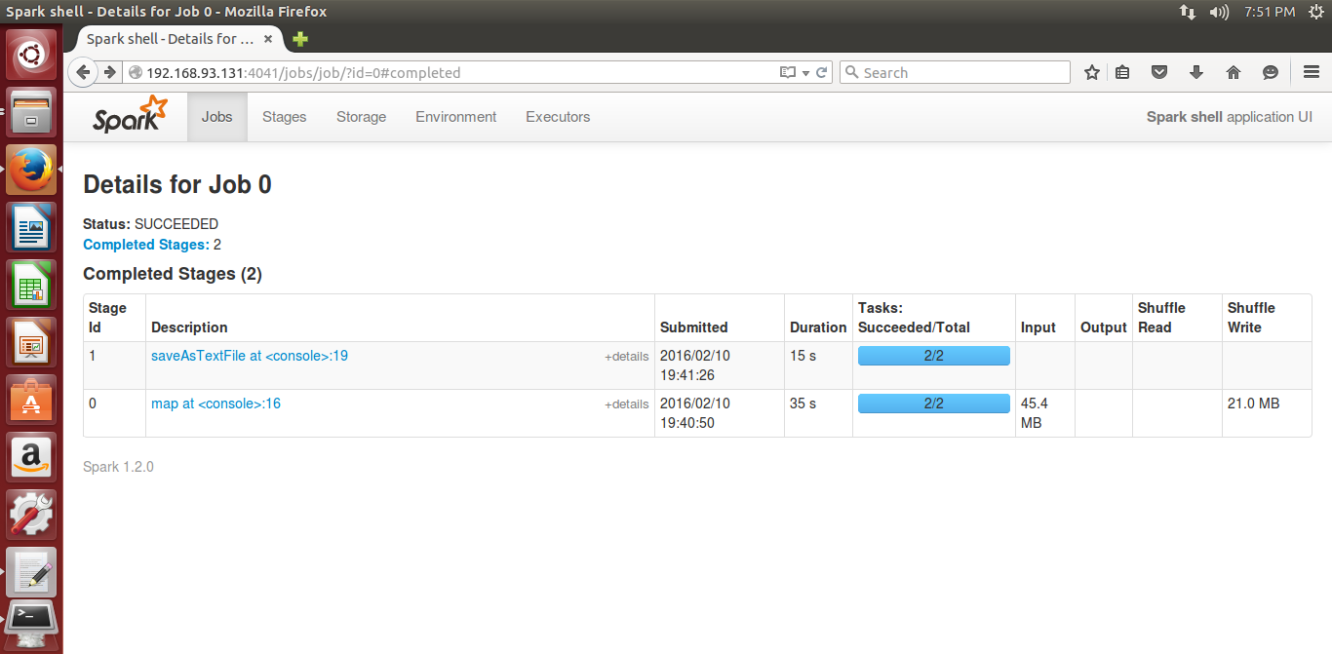
WORDCOUNT PROGRAM CONTD

Slide 10
PROJECT DATA & SOURCES
Collected raw tweet data: uploaded in Blackboard
Python code for tweet collection: UPLOADED IN BLACKBOARD
(SOURCE: http://marcobonzanini.com/2015/03/02/mining-twitter-data-with-python-part-1/)
WORDCOUNT program in SCALA: UPLOADED IN BLACKBOARD
(SOURCE: http://spark.apache.org/examples.html)
Program log files: UPLOADED IN BLACKBOARD

